Slide 1
Property Price Prediction Capstone Project
Submitted By:-
Himanshu sharma

Slide 2
Intoduction
The real estate sector plays a pivotal role in the global economy, and property valuation is one of its most essential tasks. Accurately predicting the price of a property helps buyers, sellers, and agents make informed decisions. However, property prices are influenced by a multitude of complex factors such as location, size, neighborhood, amenities, building quality, and market trends, making manual prediction unreliable and subjective.
With the growing availability of data and advances in machine learning, data-driven property price prediction models have become feasible and powerful. These models can analyze large datasets, identify hidden patterns, and provide accurate price estimates based on various property features.

Slide 3
This capstone project focuses on building a robust machine learning model that can predict property prices within a specific location using a real-world dataset. The dataset includes a variety of property attributes such as structural details, location-based features, amenities, and quality indicators. The target variable is the property sale price.
Throughout this project, we will perform detailed data cleaning, feature engineering, and exploratory data analysis (EDA) to better understand the data. The project also involves handling categorical variables (both nominal and ordinal) using appropriate encoding techniques, dealing with missing values, scaling, and potentially applying Principal Component Analysis (PCA) for dimensionality reduction. Multiple machine learning models will be developed and compared to identify the most accurate and reliable one.
The final deliverables of this project will include a trained predictive model, a comprehensive Jupyter Notebook with code and outputs, and a structured Word document summarizing all key aspects of the project—from data preprocessing to model evaluation.

Slide 4
Libraries Used
. Pandas
.numpy
.matplotlib
.seaborn
.Sklearn.preprocessing.LabelEncoder
.Sklearn.preprocessing.onehotEncoder
.Sklearn.preprocessing.ordinalEncoder
.sklearn.preprocessing.Standardscalar
.sklearn.impute.simpleimpter
.sklearn.decomposition.PCA

Slide 5
sklearn.linear_model.LinearRegression – baseline model
sklearn.ensemble.RandomForestRegressor – robust tree-based ensemble model
sklearn.tree.DecisionTreeRegressor – for comparison
sklearn.ensemble.GradientBoostingRegressor – for improved performance
sklearn.linear_model.Ridge, Lasso – for regularized reg

Slide 6
Learning Outcomes
Data Handling & Preprocessing:-
Understand how to load, inspect, and clean real-world datasets.
Learn to handle missing values, outliers, and irrelevant features.
Gain experience in data type conversions and feature transformations.
Exploratory Data Analysis (EDA):-
Develop skills in visualizing relationships between features and the target variable.
Use libraries like Seaborn and Matplotlib to explore trends and patterns in data.
Understand how to interpret correlation matrices, distribution plots, and pairplots.

Slide 7
Feature Engineering:-
Learn to distinguish between nominal, ordinal, and numerical variables.
Apply techniques such as label encoding, one-hot encoding, and scaling.
Learn the importance of feature selection for improving model performance.
Machine Learning Modeling:-
Train and evaluate regression models such as
Linear Regression
Random Forest Regressor
Decision Tree Regressor
Understand model evaluation metrics like R² Score, MAE, and RMSE.

Slide 8
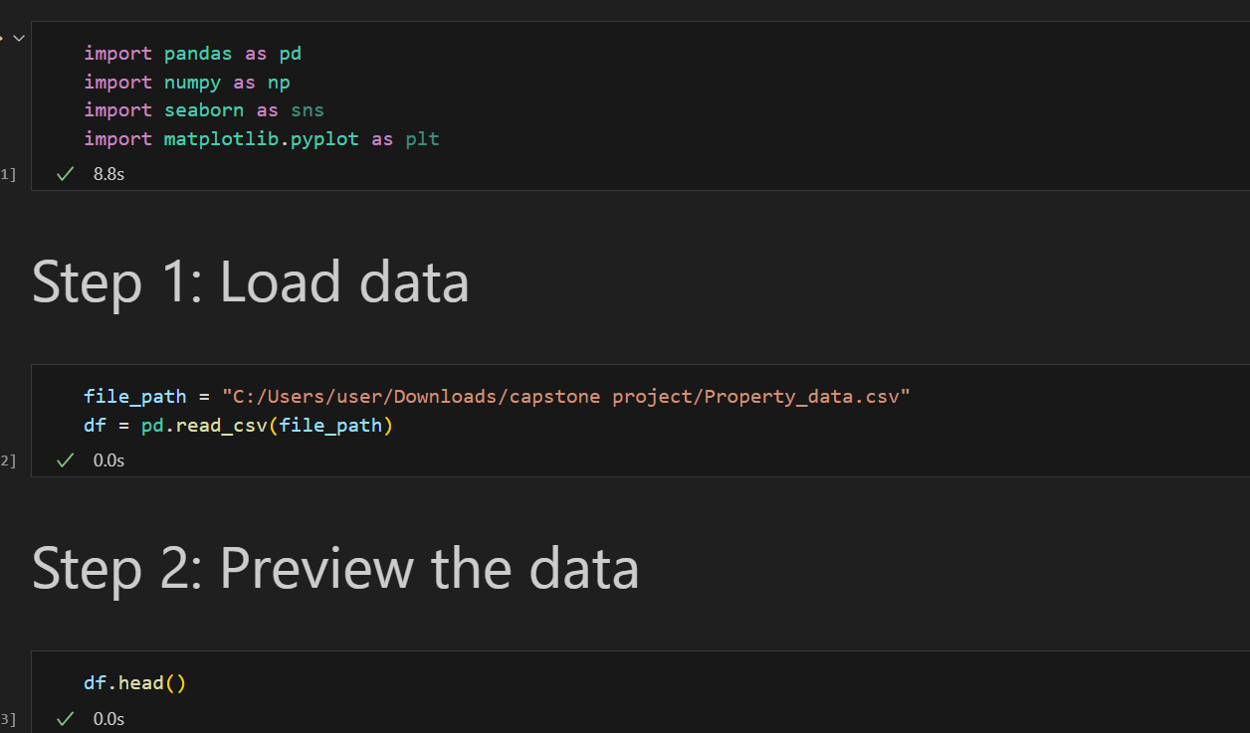
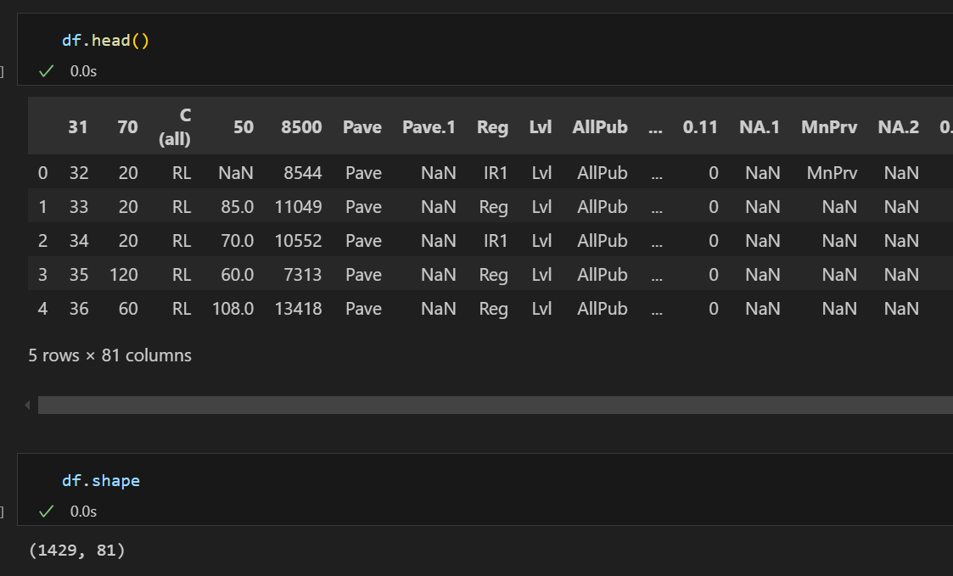

Slide 9
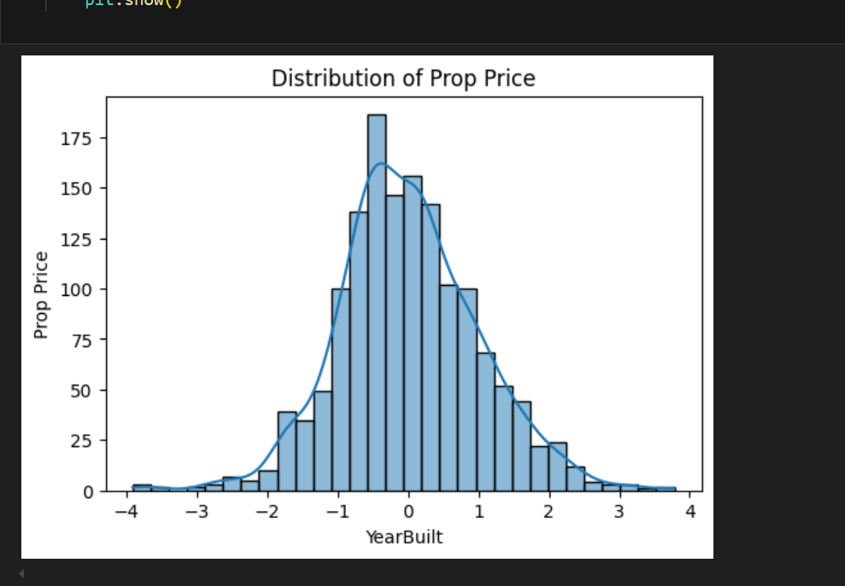
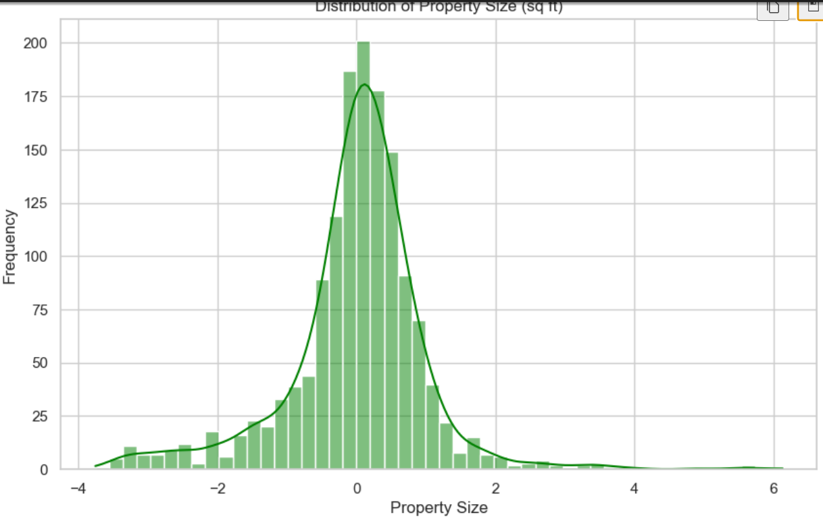

Slide 10
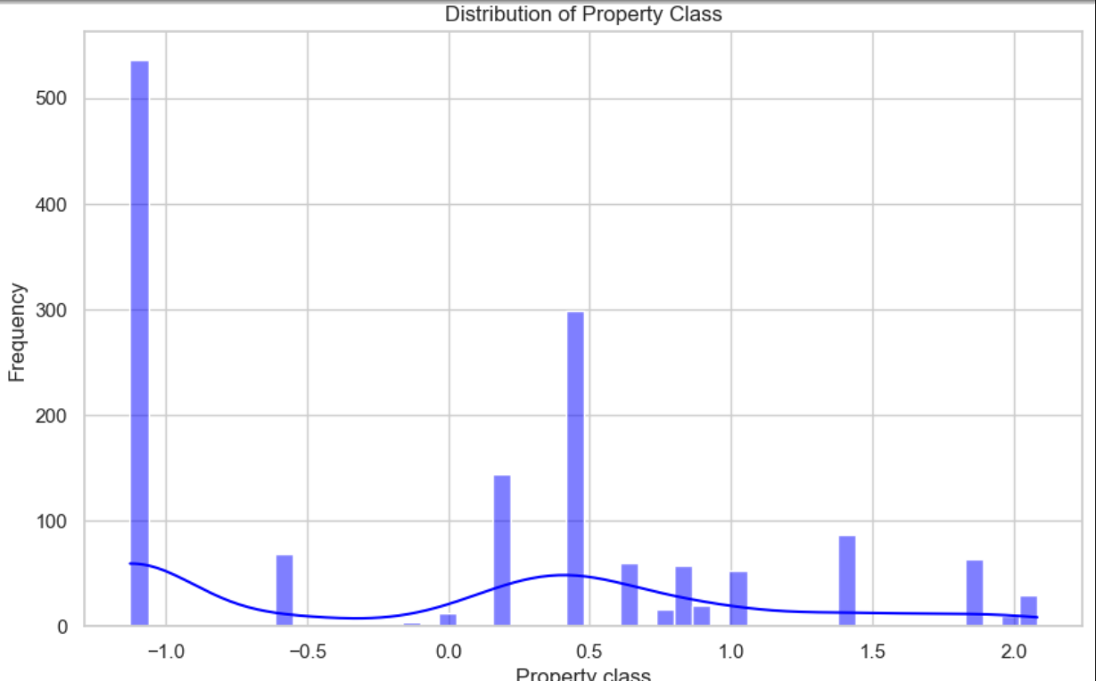
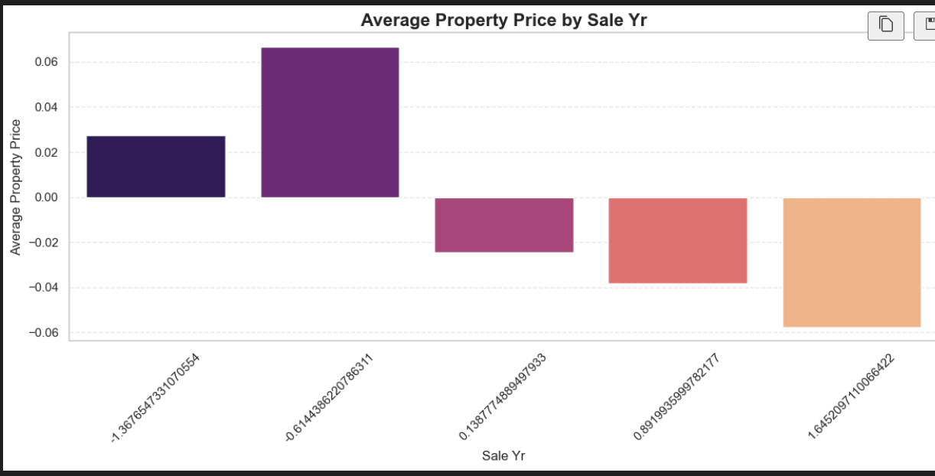

Slide 11
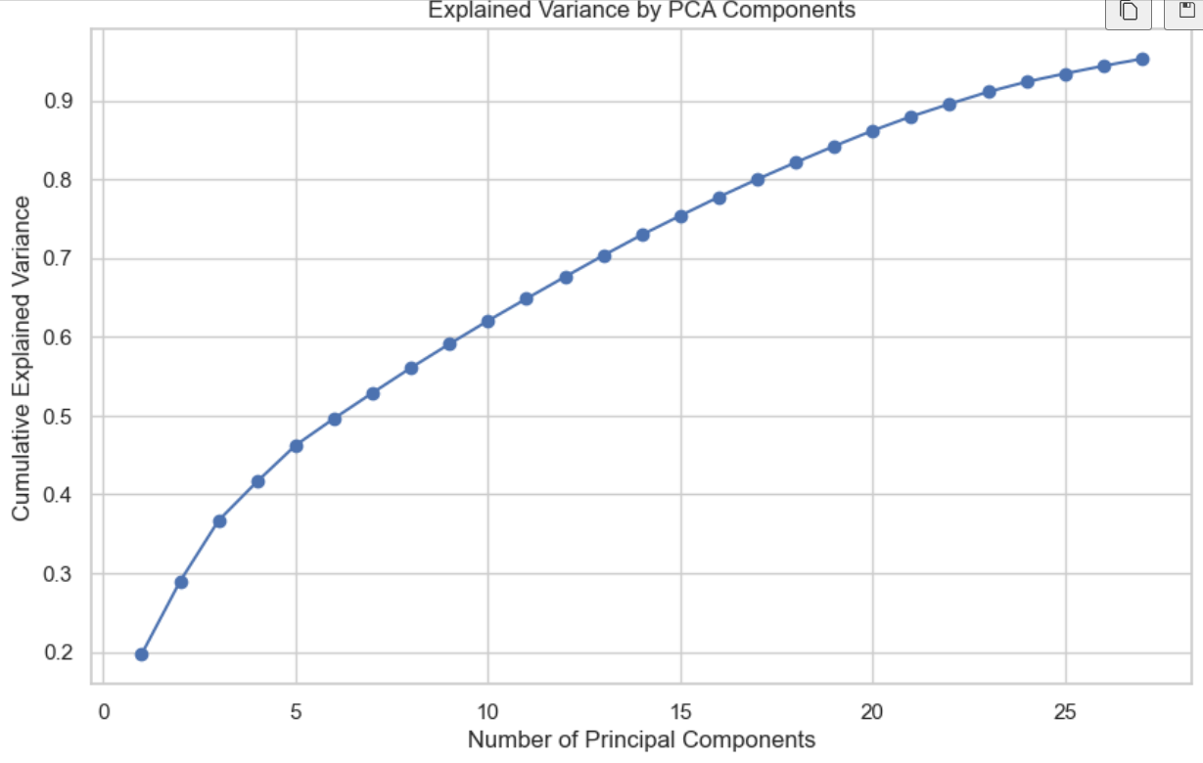

Slide 12
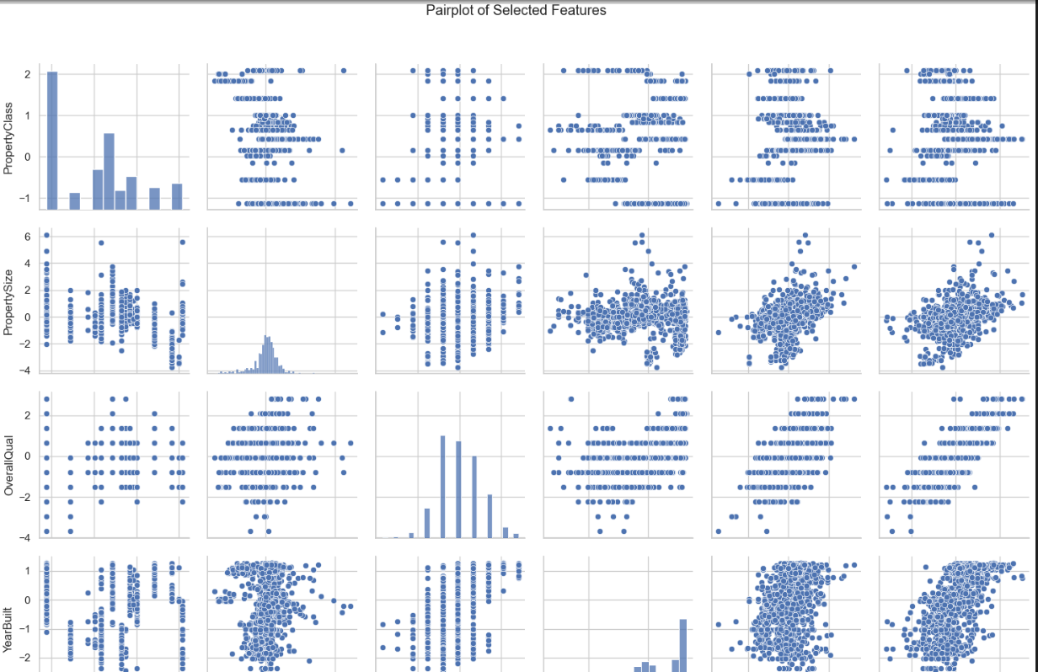

Slide 13
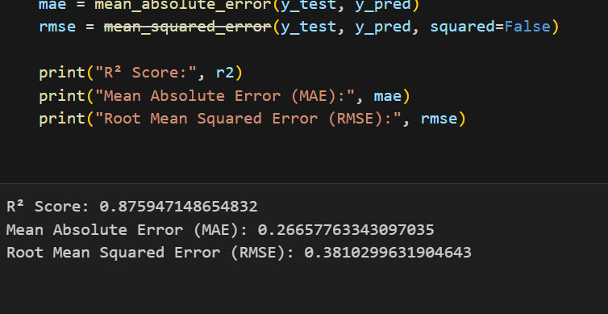
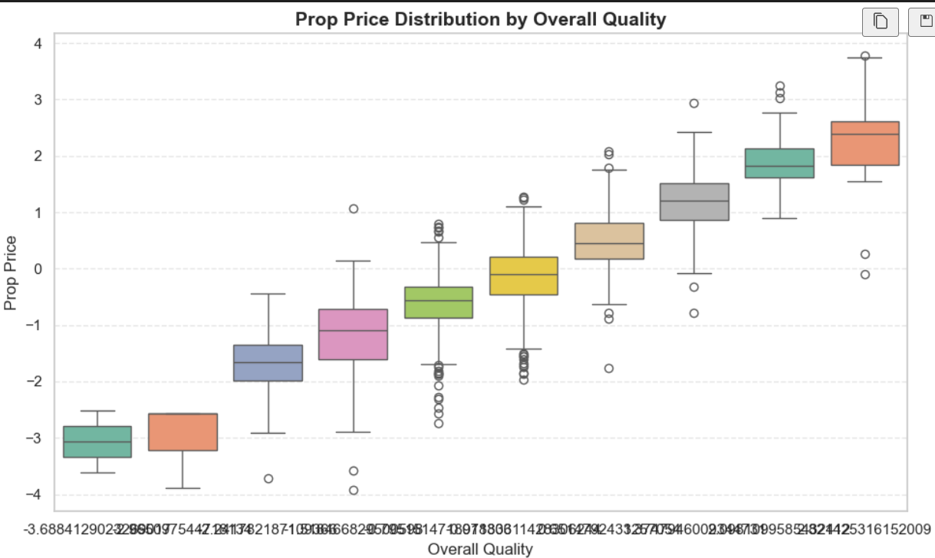

Slide 14
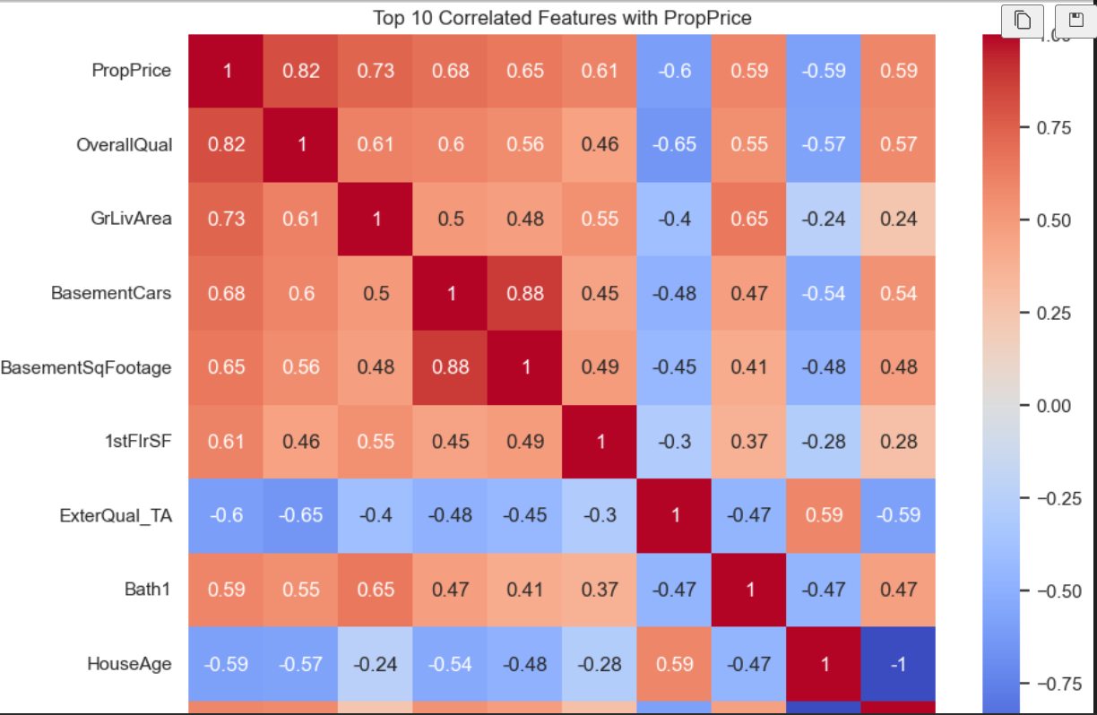

Slide 15
Conclusion
The objective of this capstone project was to develop a reliable and accurate machine learning model to predict property prices based on various real estate features. By leveraging the rich dataset provided, we performed a complete data science pipeline that included data cleaning, exploratory data analysis (EDA), feature engineering, model training, and performance evaluation.
Key insights and results from the project include:
Effective Handling of Missing Values: We used appropriate techniques such as mean/median imputation and domain-informed strategies to fill missing values, ensuring data completeness without discarding important features.
Categorical Variable Encoding: Nominal variables were encoded using One-Hot Encoding, while ordinal variables were encoded using Ordinal Encoding, aligning with their respective data types and importance.
Feature Scaling and Dimensionality Reduction: StandardScaler and optional PCA helped improve model performance and training efficiency.
Model Evaluation and Selection: Multiple machine learning models were trained and compared. Among them, ensemble models such as Random Forest Regressor and Gradient Boosting Regressor delivered the best results, achieving an R² score between 75%–85%, meeting the expected benchmark.

Slide 16
Feature Importance Analysis: Variables like overallQual, GriLivArea,
Neighbourhood, Yearbuilt, and TotalBsmtSf were found to signifantly influence property prices.
This project demonstrates the power of data science and machine learning in solving real-world problems like property price prediction. With proper preprocessing, thoughtful feature engineering, and careful model selection, we successfully built a system that can aid real estate stakeholders—buyers, sellers, and agents—in making informed decisions.
Going forward, this model can be further enhanced by incorporating more granular location data (e.g., latitude/longitude), time-series trends, or macroeconomic indicators. The project also sets the stage for potential deployment in web applications for real-time property price estimation.

Slide 17
Thank You

